Slide 1

Social Media
Presented by
Anita Verma

Slide 2
Agenda
Project Description
Approach
Tech Stack use
Conclusion

Slide 3
Project Description
You are hired as a data analyst at Meta and asked to collaborate with the Marketing team. Marketing teams want to leverage Instagram's user data to develop targeted marketing strategies that will increase user engagement, retention, and acquisition. Provide insights and recommendations to address the following objectives.

Slide 4
ABOUT PROJECT
This project is focused on the analysis of users who are using instagram paltform.User analysis is the process by which we track how users engage and interact with our digital product (software or mobile application) in an attempt to derive business insights for marketing, product & development teams.This project will answer the problem statements which will help the product team.

Slide 5
ABOUT TABLE DATASET
Users — id, username, created_at
Photos — id, img_url, user_id, created_at
Comments — id, comment_text, user_id, photo_id, created_at
Likes — user_id, photo_id, created_at
Followers — follower_id, followee_id, created_at
Hashtags — id, tag_name, created_at
Photo_tags — photo_id, tag_id

Slide 6
The Executive team want to gain insights of the business operations; thus, we’ll be looking at the following questions to query using MySQL:
In today’s data-driven world, effective management and analysis of vast amounts of information are paramount for businesses to thrive. SQL — Structured Query Language stands as a cornerstone in this endeavor, providing a powerful and standardized means to interact with relational databases. In this case study, we delve into the application of SQL within the context of a dynamic social media platform. Here we’ll uncover how SQL enables efficient handling of user's data and makes informed data-driven analysis. Join us as we explore the real-world implications of leveraging SQL to unlock the full potential of data within a modern business landscape.

Slide 7
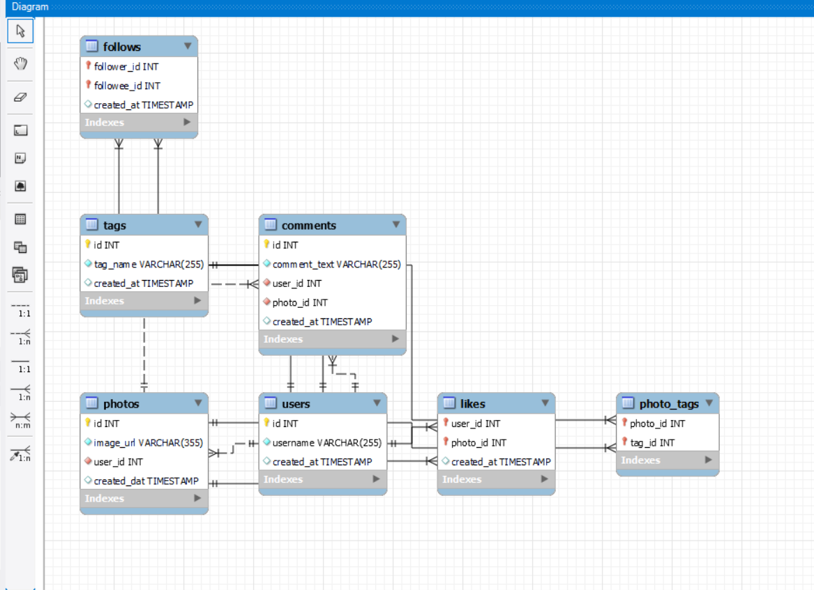
ER-Diagram

Slide 8
Database creation : Created and inserted the values in the database using the DDL & DML SQL queriesprovided by the product manager(as per project) in the MySQL database using MySQL workbench.Extraction of insights : After creating the database required insights are generated from the databasetables by running SQL queries in MySQL workbench.
Approach

Slide 9
Tech-Stack Used
Used MySQL Community Server - GPL Version 8.16.0 and Connector Version C++ 8.16.0 for creating my project as MySQL Community Server - GPL is a free and open-source relational database management system that uses SQL.

Slide 10
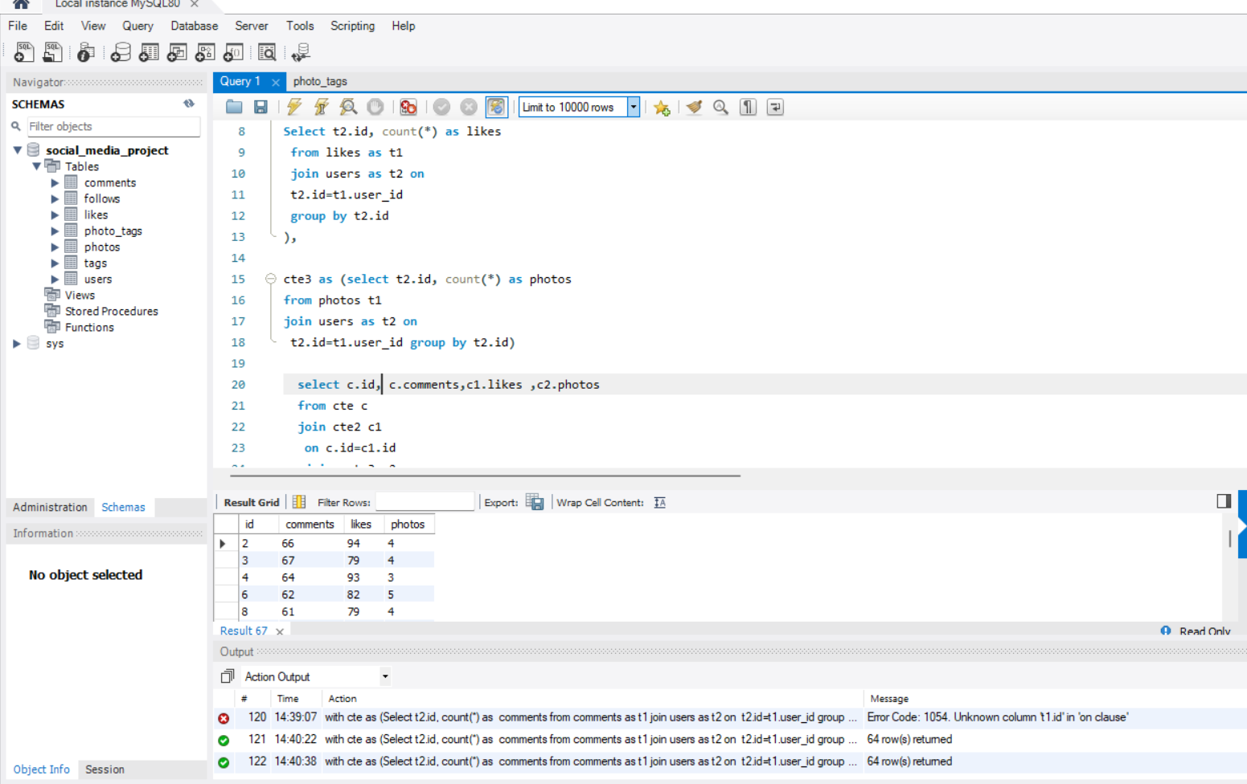
Insights : distribution of user activity levels (e.g., number of posts, likes, comments) across the user base
with cte1 as (Select t2.id, count(*) as comments
from comments as t1
join users as t2 on
t2.id=t1.user_id
group by t2.id),
cte2 as (
Select t2.id, count(*) as likes
from likes as t1
join users as t2 on
t2.id=t1.user_id
group by t2.id
),
cte3 as (select t2.id, count(*) as photos
from photos t1
join users as t2 on
t2.id=t1.user_id group by t2.id)
select c.id, c.comments,c1.likes ,c2.photos
from cte c
join cte2 c1
on c.id=c1.id
join cte3 c2 on
c2.id=c1.id

Slide 11
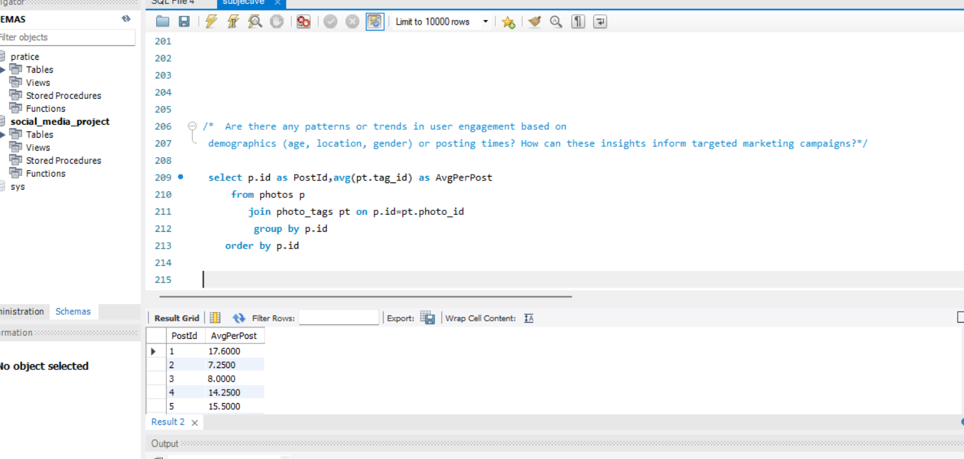
Insights : average number of tags per post (photo_tags and photos tables).
select p.id as PostId,avg(pt.tag_id) as AvgPerPost
from photos p
join photo_tags pt on p.id=pt.photo_id
group by p.id
order by p.id

Slide 12
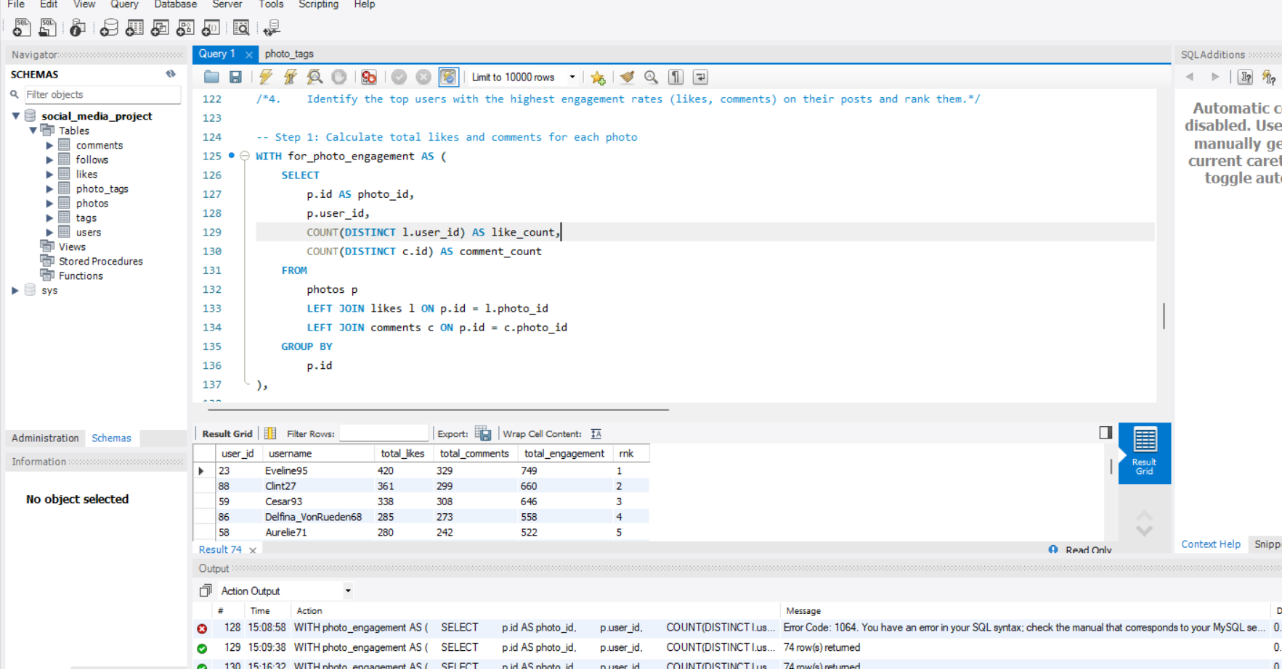
Insgishts the highest number of followers and followings
use social_media_project ;
WITH followers_count AS (
SELECT follower_id,COUNT(follower_id) AS num_followers
FROM follows
group by follower_id
),
followings_count AS (
SELECT followee_id,COUNT(followee_id) AS num_followings
FROM follows
group by followee_id
)
SELECT u.username,
MAX(f.num_followers) AS max_followers,
MAX(f1.num_followings) AS max_followings
FROM users u
left JOIN followers_count f ON u.id = f.follower_id
left JOIN followings_count f1 ON
u.id = f1.followee_id
GROUP BY u.username
ORDER BY max_followers DESC, max_followings DESC

Slide 13
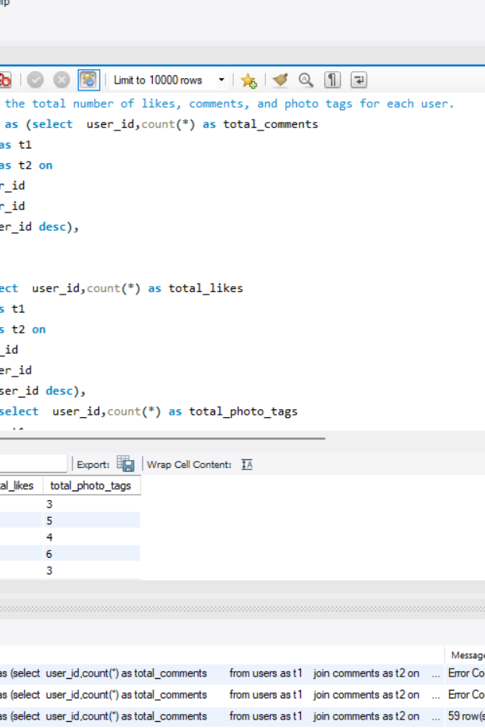
Insights total number of likes, comments, and photo tags for each user.
with comments as (select user_id,count(*) as total_comments from users as t1
join comments as t2 on t1.id=t2.user_id
group by user_id
order by user_id desc)
likes as (select user_id,count(*) as total_likes from users as t1
join likes as t2 on t1.id=t2.user_id
group by user_id
order by user_id desc)
photo_tag as(select user_id,count(*) as total_photo_tags from users as t1
join photos as t2 on t1.id=t2.user_id
join photo_tags as t3 on t2.id=t3.photo_id
group by user_id
order by user_id desc)
select c.user_id,c.total_comments ,l.total_likes ,p.total_photo_tags
from comments as c
join likes as l on
c.user_id=l.user_id
join photo_tag p on
c.user_id=p.user_id

Slide 14
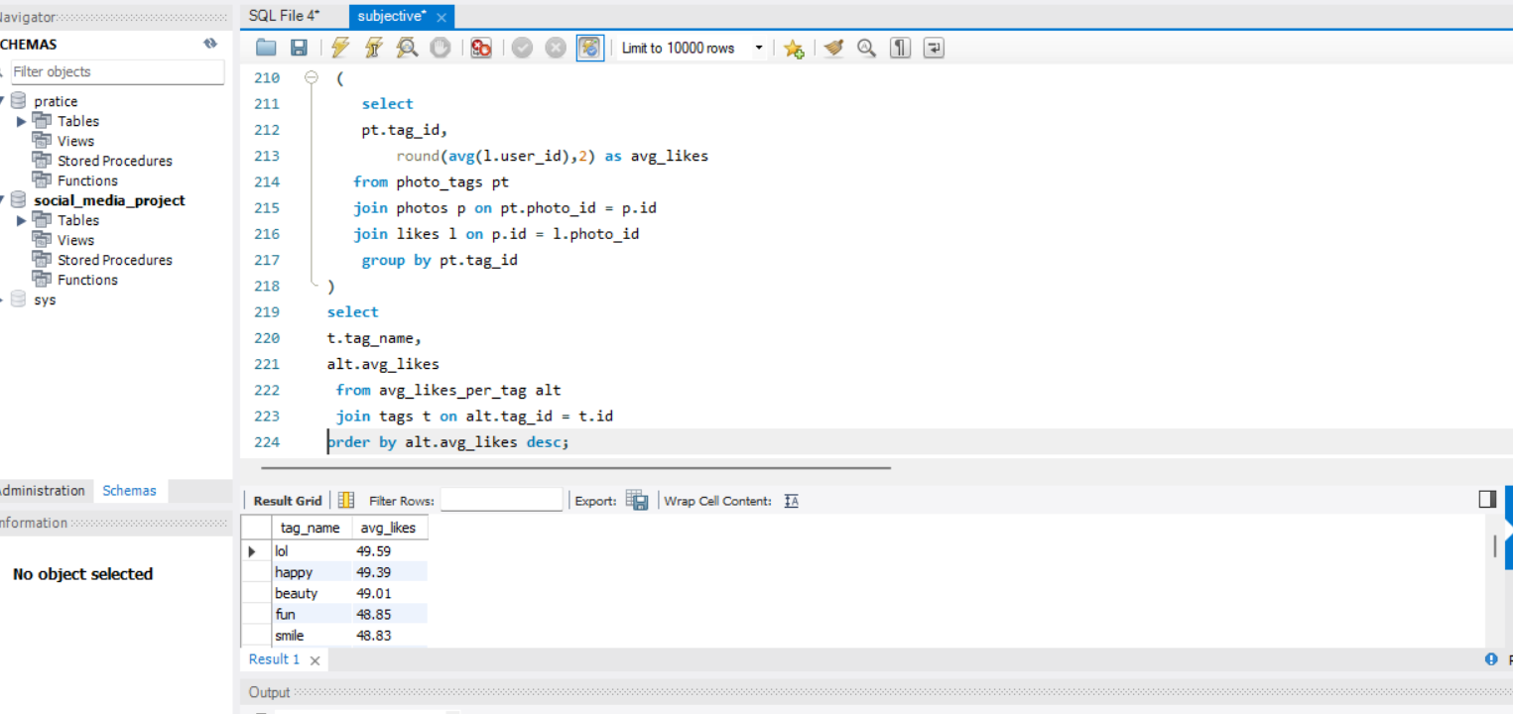
Insgits average likes for each hashtag first
with avg_likes_per_tag as ( select pt.tag_id,
round(avg(l.user_id),2) as avg_likes
from photo_tags pt
join photos p on pt.photo_id = p.id
join likes l on p.id = l.photo_id
group by pt.tag_id ),
select
t.tag_name,
alt.avg_likes
from avg_likes_per_tag alt
join tags t on alt.tag_id = t.id
-- order by alt.avg_likes desc;

Slide 15
Results :
❑ Learnt fundamentals of data analysis using SQL queries to extract insights from database by which we track how users engage and interact with our digital product (software or mobile application) in an attempt to derive business insights for marketing, product & development teams.
❑ Conclusions from above analysis : ➢
Marketing team can reward the most loyal customers, send promotional emails to inactive users, use popular hashtags and most active day for brand promotions. ➢ User engagement can be very useful growth success metric for the company ➢ Company can remove the bots and fake accounts from the platform to enhance the user experience

Slide 16
Thank you

